Slide 1

Predicting Stock Prices for Business Through Historical Events
Team Members:
Akshitha Karthick Kumar
Babitha Govindaiah
Gabriella Albarez
Nirali Karsaliya
Pooja Priya
Notes:
Hi everyone! We will be discussing with you all today a business scenario and machine learning models for predicting stock prices for a company through historical news data

Slide 2

Contents
Business scenario
Problem Statement
Data description
Natural Language Processing
Data Insights
Machine learning techniques
Modeling Results
Conclusion
Notes:
This is a brief overview of what we will be going over today. Starting with our business scenario and problem statement. Then we will go over a bit about our data and machine learning models. Lastly, we will conclude with our modeling results

Slide 3

Business Scenario
CardinalHood is a brokerage company that collects news data on the US stock market and uses that information to generate predictions on stock market prices for its investors.
The goal is to increase the company’s customer base, considering fluctuating stock prices in recent times.
Notes:
Our business scenario involves a brokerage company, CardinalHood, which collects data on news to make stock market price predictions for investors
The goal of the company is to increase their number of investors by accurately predicting stock prices

Slide 4

Problem statement
CardinalHood needs to develop a machine learning algorithm to generate accurate stock market price predictions.
CardinalHood’s Machine Learning engineers should develop a robust machine learning algorithm that will best fit the requirements to achieve company goals.
Notes:
CardinalHood executives want to develop an ML model that will help in stock market price analysis and determine if there is a correlation between news headlines and stock prices.
They have hired ML engineers to develop this model to help reach their goals.

Slide 5
Building Machine Learning Models with PySpark
Approach:
Data Extraction & Cleanup
Sentiment Analysis on News Data
Data Sampling on Stock Data (Splitting train/test dataset = 80/20)
Build ML algorithm on Training Dataset
Evaluate model Performance on Test Data
Verify Results

Slide 6


Data Description
Two years of data:
Stock prices
NYT headlines
Average of closing stock prices by day for the four industries: Tech, Health, Manufacturing, and Finance

Slide 7
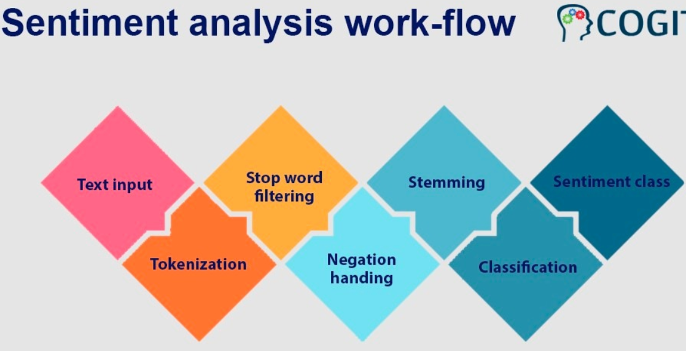
Natural Language Processing
Convert keywords in the headlines to values
Positive and negative scores from "Sentiment Analysis" of news data for model building

Slide 8
Feature Description
Independent Variable: Positive and negative scores from Sentiment Analysis
Dependent Variable: Closing Price of Stocks

Slide 9
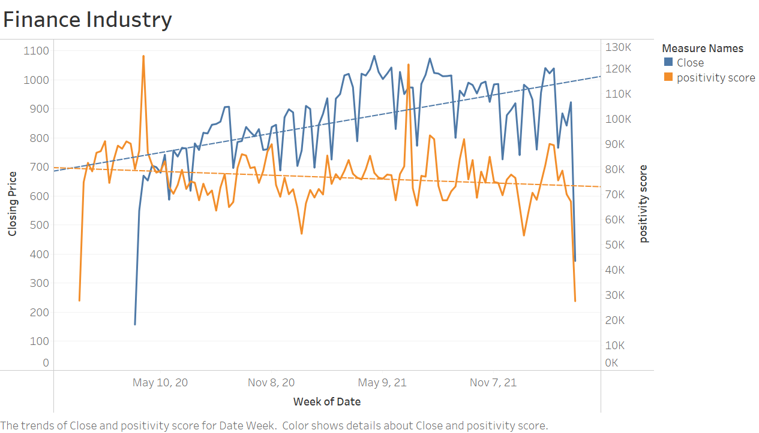
Data Insights

Slide 10
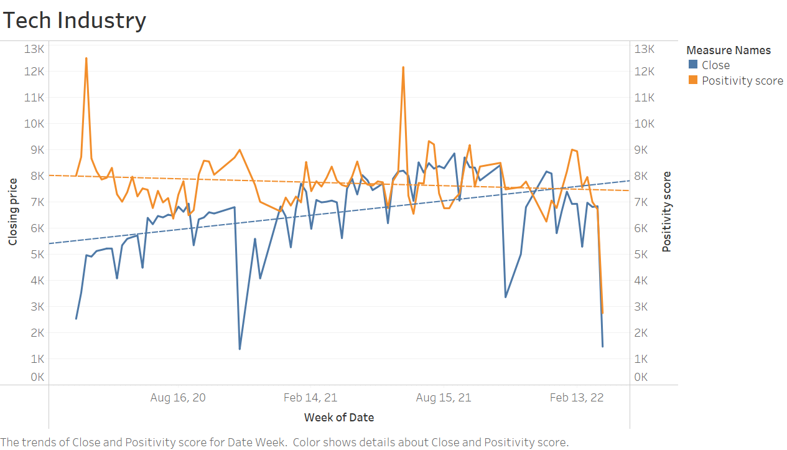
Data Insights

Slide 11
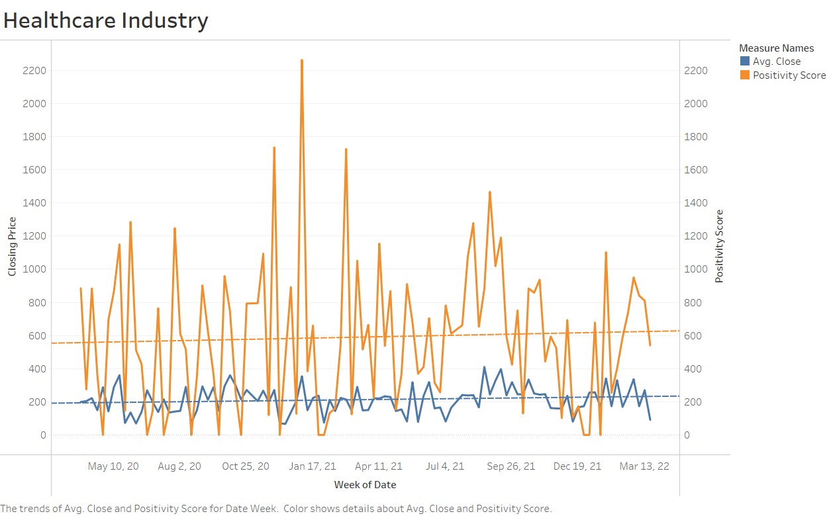
Data Insights

Slide 12
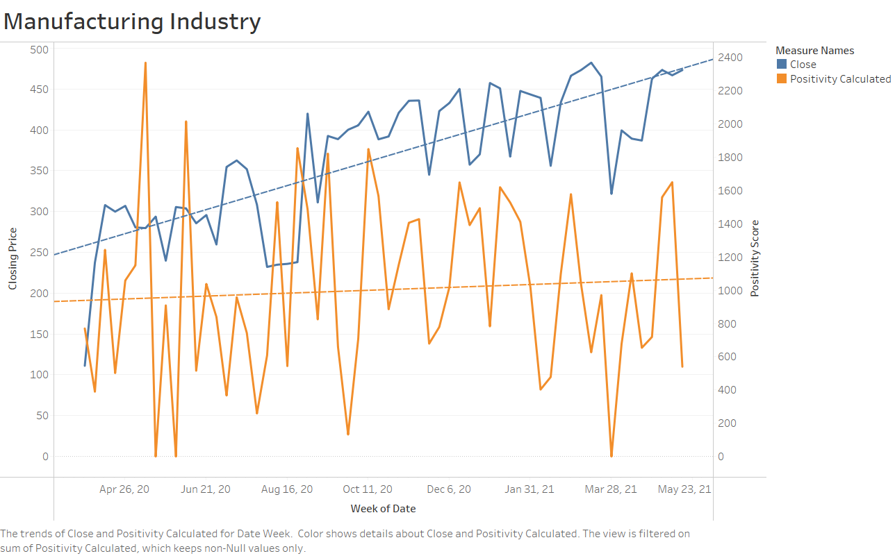
Data Insights

Slide 13
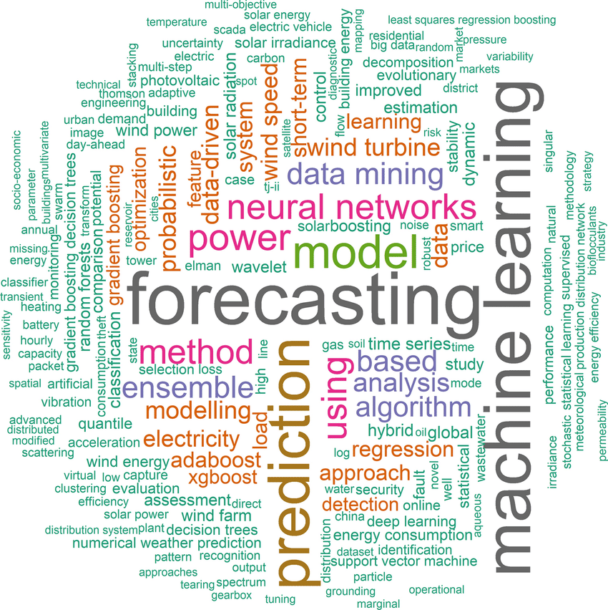
Machine Learning Techniques
Below are the machine learning techniques which were considered for this business scenario:
1) Linear Regression
2) Decision Tree
3) Gradient Boosting Decision Tree

Slide 14
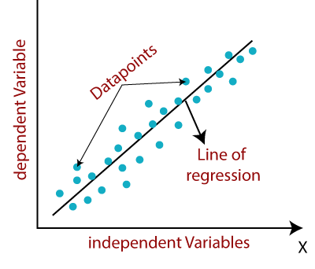
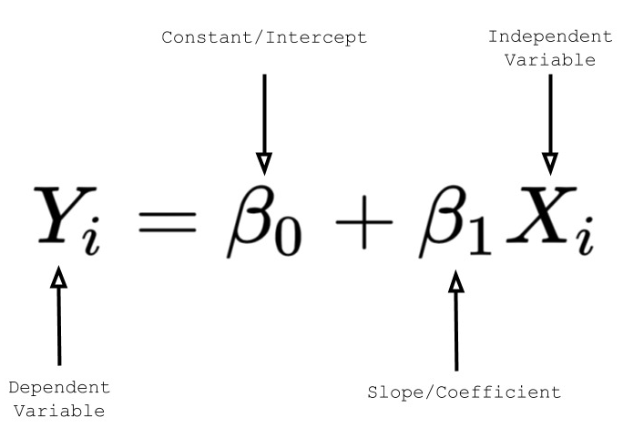
1. Linear Regression
Commonly used for predictive analysis and modeling the relationship between the scalar response and one or more explanatory variables

Slide 15
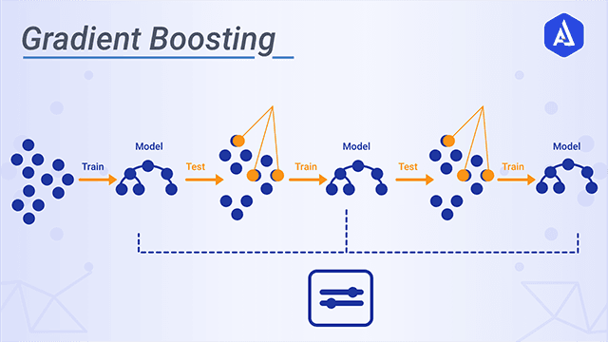
2. Gradient Boosting Decision Tree
The key idea is to set the target outcomes for this next model in order to minimize the bias error
Gradient boosting decision tree involves three elements:
A loss function to be optimized.
A weak learner to make predictions.
An additive model to add weak learners to minimize the loss function

Slide 16
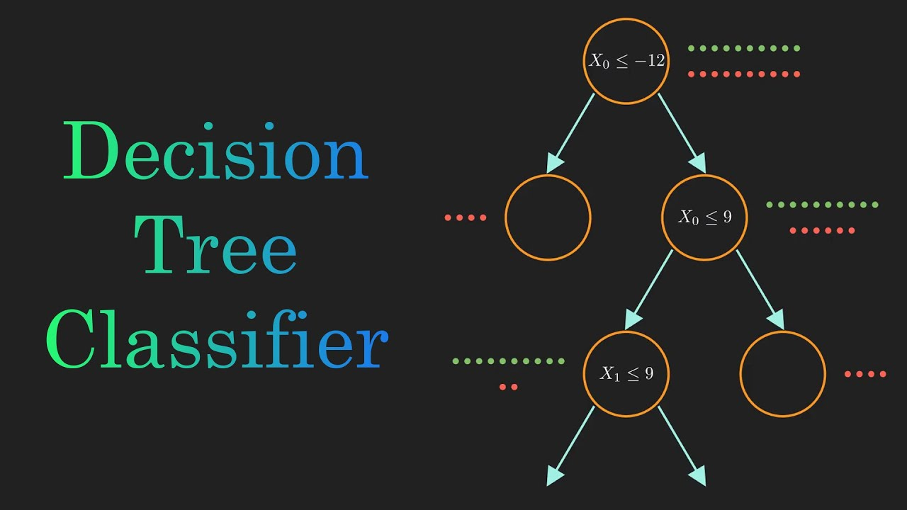
Decision Tree
Supervised method that utilizes classification and regression
Predicts target variables by creating decision rules based on data it is fed
It can be easy to understand and implement
Can take numerical and categorical data
Applies logarithmic computation

Slide 17
Linear Regression Model Results
Finance | Technology
RMSE: 19.76 | RMSE: 37.48
Manufacturing | Healthcare
RMSE: 21.56 | RMSE: 6.2
Notes:
RMSE score results from analysis. Generally lower rmse scores indicate a better fit and accuracy. We see here a moderately appealing rmse score for FTM and the lowest rmse for healthcare, indicating that healthcare has the best correlation out of the 4 industries with the positive and negative sentiment scores

Slide 18
Decision Tree Model Results
Finance | Technology
RMSE: 24.22 | RMSE: 80.87
Manufacturing | Healthcare
RMSE: 23.44 | RMSE: 6.5

Slide 19
Gradient Boosted Decision Tree Model Results
Finance | Technology
RMSE: 23.92 | RMSE: 80.87
Manufacturing | Healthcare
RMSE: 23.82 | RMSE: 6.6

Slide 20
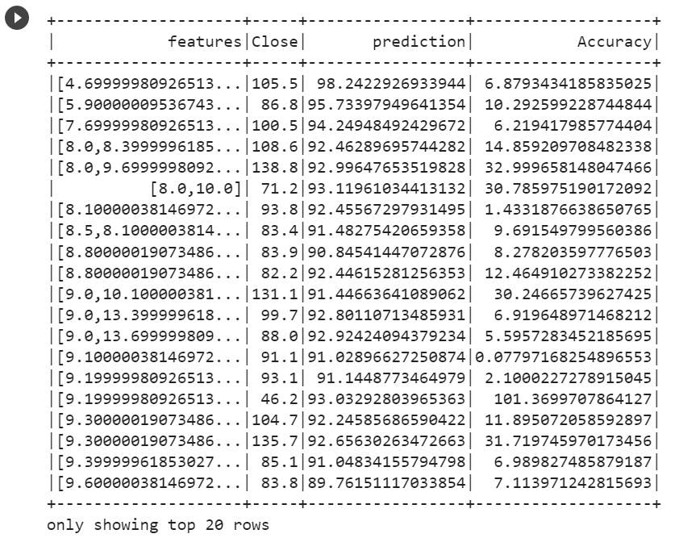
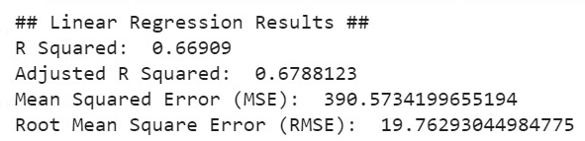
Regression Summary
Notes:
Shows closing price, predictions, and accuracy of the prediction for manufacturing industry
Linear reg results shows R squared is close to 1, so the values are closely correlated

Slide 21
Model Comparison
All 3 models display approximately similar results for each industry.
Linear regression model appears to have lowest RMSE scores overall
Linear Regression | Decision Tree | Gradient Boosting Decision Tree
19.76 | 24.22 | 23.92

Slide 22
Conclusion
There is a correlation between news article headlines and stock price fluctuations
Predicting stock prices is possible using Machine Learning Techniques
Analysis with various machine learning models aids in detecting patterns within the data
Notes:
CardinalHood can use machine learning models to help correlate stock prices based on news data. The company should use the linear regression ml model, as this gives the best accuracy. Overall, there are many ml models available that can be used to predict stock prices based on news data.

Slide 23
Thank you!

